Slide 1

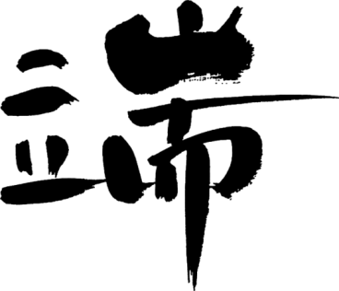

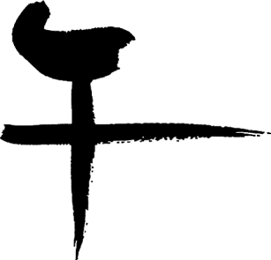
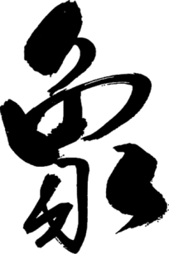
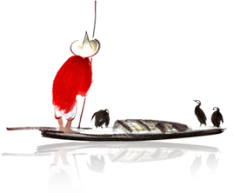
The Dragon Boat Festival
英
文
介
绍

Slide 2

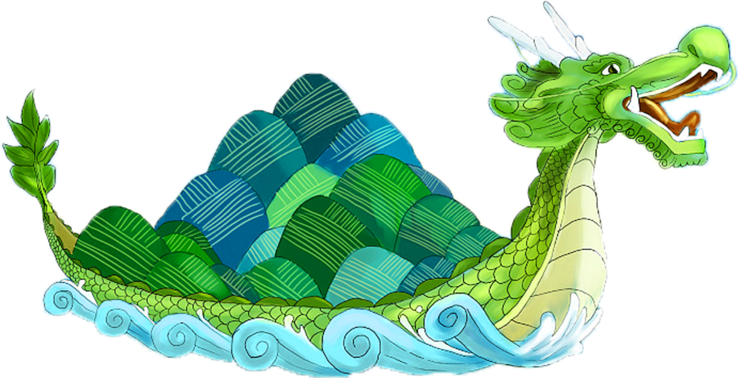
目
The Dragon Boat Festival
The Content
Origin of Dragon Boat Festival
端午的由来
录
1
Custom of Dragon Boat Festival
端午的习俗
2
The Dragon Boat Festival in other countries
其他国家的端午节日
3

Slide 3

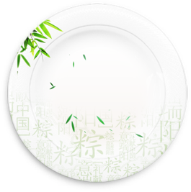
壹
Origin of Dragon Boat Festival
由来

Slide 4
THE INTRODUCTION
The Dragon Boat Festival， also called the Duanwu Festival， is celebrated on the fifth day of the fifth month according to the Chinese calendar. This festival is to commemorate the death of QU Yuan， an upright and honest poet and statesman who is said to have committed suicide by drowning himself in a river.
介绍
端午节，也称端午节，是根据中国历法在第五个月的第五天庆祝的。这个节日是为了纪念屈原的死，他是一个正直诚实的诗人和政治家，据说他自尽于河中。

Slide 5
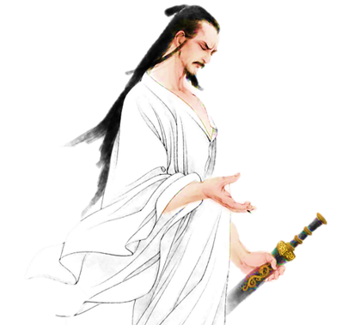
HISTORY
The Dragon Boat Festival, the 5th day of the 5th month in the Chinese lunar calendar, has had a history of more than 2,000 years. It is usually in June in the Solar calendar.
历史
端午节是中国古老的传统节日，始于春秋战国时期，至今已有2000多年历史。通常在阳历的六月份。

Slide 6
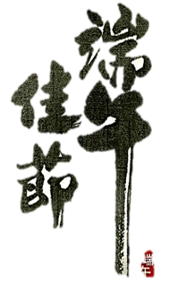
TODAY
Today, Dragon Boat Festival in the Chinese people is still a very popular grand festival. Country attaches great importance to the protection of intangible cultural heritage, May 20, 2006, the State Council approved the inclusion of the folk first batch of national intangible cultural heritage.
时至今日
时至今日，端午节在中国人民中仍是一个十分盛行的隆重节日。国家非常重视非物质文化遗产的保护，2006年5月20日，该民俗经国务院批准列入第一批国家级非物质文化遗产名录。

Slide 7
贰
Custom of Dragon Boat Festival
习俗

Slide 8
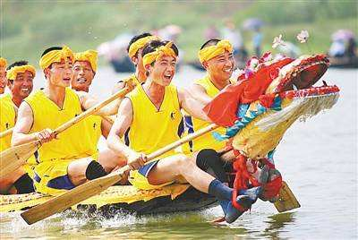

Hanging Pictures of Zhong Kui 悬挂钟馗像
Hanging Calamus and Moxa 挂艾叶、菖蒲
Dragon Boat Race 赛龙舟
The Culture of Zongzi 粽子
Spice Bag 香囊
Realgar Wine 雄黄酒
Travel sickness 游百病

Slide 9
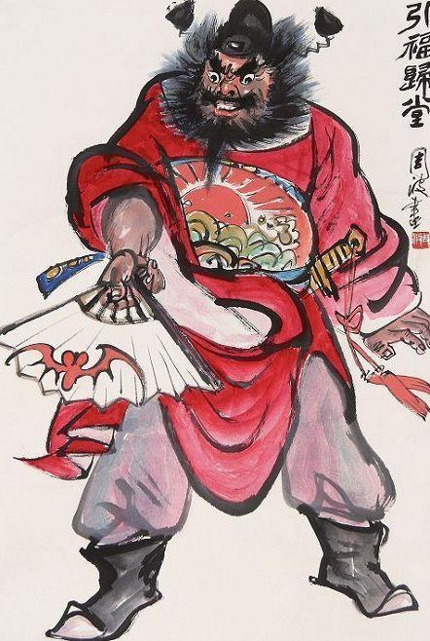
Hanging Pictures of Zhong Kui
悬挂钟馗像
Zhong Kui is right in the south. In Chinese folklore, God can drive away evil spirits and drive away evil spirits. In the old days, Chinese folk often hung Zhong Kui's image to ward off evil spirits and eliminate calamity.
钟馗，字正南，中国民间传说中能打鬼驱除邪祟的神。旧时中国民间常挂钟馗的像辟邪除灾。
节日PPT模板 http://www.1ppt.com/jieri/

Slide 10
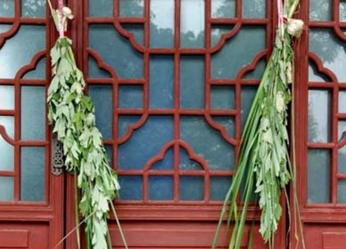
Hanging Calamus and Moxa
挂艾叶、菖蒲
Acorus is a Chinese folk festival custom, in the Dragon Boat Festival with the leaf in the hall hanging in the hall, cut Aili tiger shaped or cut color for small tigers, pasted with AI leaves, women strive to wear, in the secluded evil drive miasma. Using calamus as a sword and inserting it on the door couch, there is the magic effect of exorcism.
挂艾叶菖蒲是中国民间节日习俗，在端午节以艾叶悬于堂中，剪艾力虎形或剪彩为小虎，贴以艾叶，妇人争相戴之，以僻邪驱瘴。用菖蒲作剑，插于门榻， 有驱魔法鬼之神效。

Slide 11
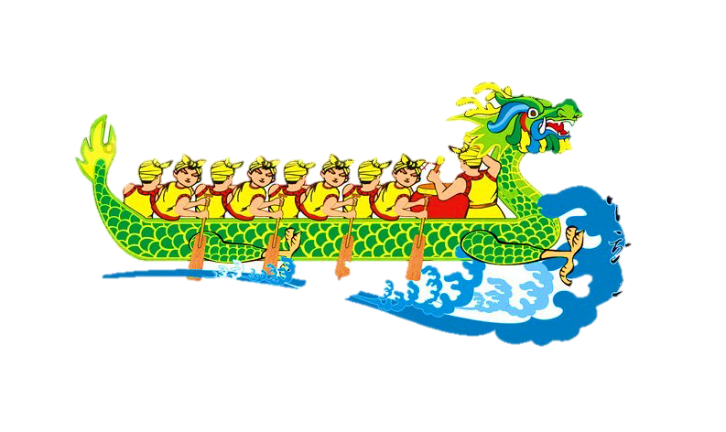
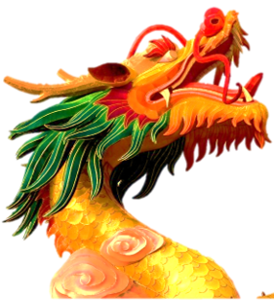
Dragon Boat Race
赛龙舟

Slide 12
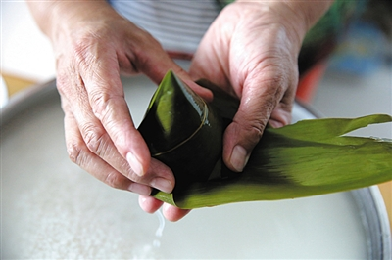
Zongzi is a traditional custom of the Dragon Boat Festival. First of all, prepare the zongzi leaves. The zongzi leaves of the old Beijing dumplings are usually reed leaves. They are called Zongye leaves on the dumplings. Next is to prepare the stuffing in the dumplings, put the stuffing in the leaves of zongzi, and the rice dumplings are finished.
包粽子是端午节的一种传统风俗。首先要准备好粽子叶，老北京包粽子的粽子叶一般是苇叶，用在包粽子上就被称为粽叶。其次则是准备粽子里面的馅料，将馅料置于粽叶中，粽子则完成了。
The Culture of Zongzi
包粽子

Slide 13
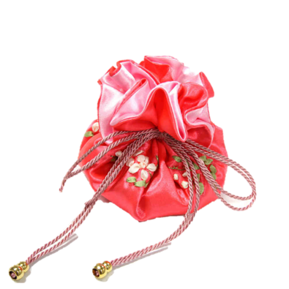
Spice Bag
配香囊
端午节最有特色的饰物就是香包。小孩佩戴香包，传说有避邪驱瘟之意。用含有多种香味的药用植物做成的香包也可以预防疾病。
The most distinctive ornament of the Dragon Boat Festival is the fragrant bag. Children wear sachets, legend has the meaning of evils. Sachets made from medicinal plants containing many flavors can also prevent diseases.

Slide 14
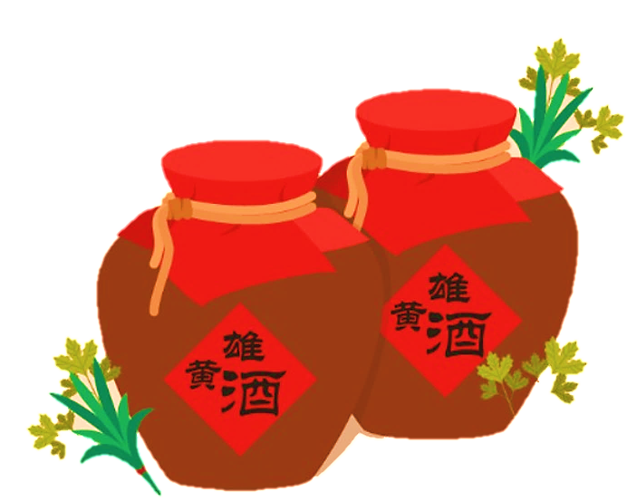
Realgar Wine
雄黄酒
It is a very popular practice to drink this kind of Chinese liquor seasoned with realgar at the Dragon Boat Festival.
This is for protection from evil and disease for the rest of the year.
In one word, all of the activities are to protect themselves from evil and honor the poet Qu Yuan。

Slide 15
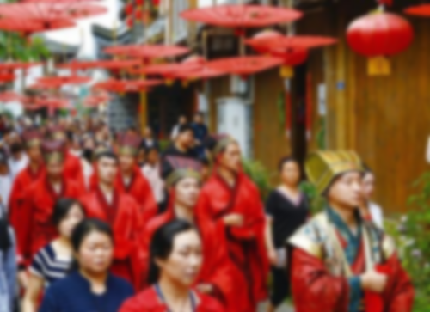
Travel sickness
游百病
Travel sickness: such practices, prevalent in the custom of the Dragon Boat Festival in Guizhou Province
游百病：此种习俗，盛行于贵州地区的端午习俗。

Slide 16
叁
The Dragon Boat Festival in other countries
他国

Slide 17
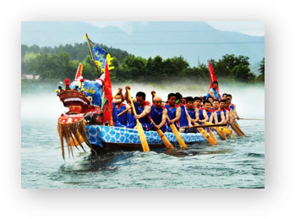
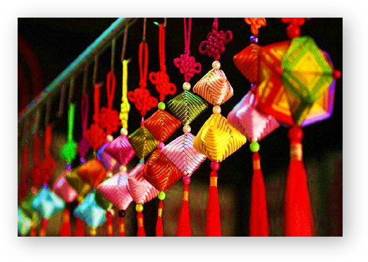

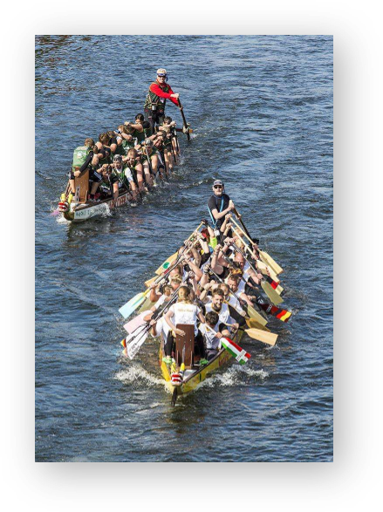
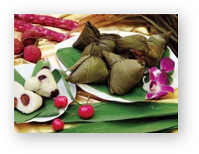


Slide 18
Since ancient times, Japan has had a tradition of Chinese festivals. In Japan, the custom of Dragon Boat Festival was introduced from China to Japan after the era of peace. From the Meiji era, festivals are changed to Gregorian calendar days. The Dragon Boat Festival in Japan is the May 5th of the Gregorian calendar. The custom of Dragon Boat Festival has been absorbed and transformed into Japanese traditional culture after its spread to Japan. The Japanese do not row dragon boats on this day, but they also eat dumplings like Chinese people and hang Acorus grass in front of the door. In 1948, the Dragon Boat Festival was officially designated as the statutory children's day by the Japanese government and became one of the five major festivals in Japan.The Dragon Boat Festival has become a traditional custom. The Japanese call it "Ai Qi Zhao Bai Fu, Pu Jian Chai thousand evil." The festival special diet is Japanese dumplings and pancakes.
【JAPAN】
日本自古以来就有过中国节的传统。在日本，端午的习惯是在平安时代以后由中国传入日本的。从明治时代开始，各节日都改为公历日。日本的端午节是公历5月5日。端午节的习俗传到日本之后，被吸收改造成为日本的传统文化。日本人在这一天不划龙舟，但也跟中国人一样会吃粽子，并在门前挂出菖蒲草。在1948年，端午节被日本政府正式定为法定的儿童节，成为日本五大节日之一。
端午节成为传统的风俗，日本人称“艾旗招百福，蒲剑斩千邪”。节日特有饮食有日本粽和柏饼。

Slide 19
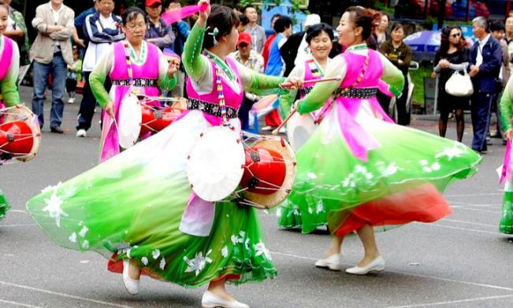
【Korean Peninsula】
People on the Korean Peninsula think that the Dragon Boat Festival is a celebration and a time to worship the sky. On the Korean Peninsula in the agricultural society, the traditional sacrificial activities that the public participated in were praying for a bumper harvest. During the ceremony, there will be activities such as masquerade, Korean wrestling, swinging and Taekwondo.
朝鲜半岛人民认为端午节是一个庆典，是祭天的时候。在农业社会时期的朝鲜半岛，民众共同参与的传统祭祀活动，祈求丰收。在祭祀举行时会进行假面舞剧、韩式摔跤、荡秋千、跆拳比赛等具有朝鲜地方特色的活动。

Slide 20

The Dragon Boat Festival

